Slide 1
EBAY SHOPPING WEBSITE
Under the guidance of
Mrs.vaishali sonawane mam

Slide 2
Introduction
eBay is a global online marketplace that connects buyers and sellers worldwide, offering a platform to trade new and pre-owned goods.
It enables individuals and businesses to list products for auction or fixed-price sale, creating a diverse e-commerce ecosystem.
With millions of listings across categories, eBay provides a convenient way to shop, sell, and discover unique items.

Slide 3
Overview
Our eBay Demo Experience
This showcases how eBay’s platform works for buyers and sellers.
It helps users understand the buying, selling, and auction features of eBay.
Explore how listings appear, manage orders, and see the seller dashboard in action.
Why Use eBay? Launch your online selling journey, list products effortlessly, and reach millions of buyers with eBay’s trusted e-commerce platform.
This provides a real-world preview of how eBay functions, helping sellers visualize their store’s potential.

Slide 4
Modules
MODULE 1: SIGN-IN PAGE
Objective:Verified the Functionality of ebays login system
Validated username (email) and password fields.
Checked error handling for invalid credentials.
Confirmed successful redirection post-login.
MODULE 2: MULTIPLE SEARCHES
Objective: Ensured the search feature returns accurate results. Tests Performed:
Tested with varied search terms (e.g., "watch," "phone," "laptop").
Verified auto-suggestions and result relevance.
Cleared search history between queries.

Slide 5
MODULE 3: ADD TO CART
Objective: Validated the cart workflow for a seamless shopping experience. Tests Performed:
Searched for a specific item ("VIVO S1 Pro Mobile").
Added the item to cart and verified cart updates.
Returned to the homepage post-addition.
MODULE 4: REMOVE FROM CART
Objective: Ensured users can easily modify their cart. Tests Performed:
Navigated to the cart and removed the added item.
Confirmed cart updates and return to homepage.

Slide 6
MODULE 5: UPDATE USERNAME (ACCOUNT SETTINGS)
Objective: Validate the functionality to modify the user's display name. Tests Performed:
Navigated to account settings and edited the username.
Verified field clearance, new input acceptance, and save confirmation.
Re-authenticated post-update to ensure security.
MODULE 6: UPDATE ADDRESS (ACCOUNT SETTINGS)
Objective: Verify address modification in user profile. Tests Performed:
Edited address fields (street, city, state, postal code).
Confirmed submission and error handling for invalid inputs.

Slide 7
MODULE 7: SHOP BY CATEGORY (NAVIGATION)
Objective: Test category-based product browsing. Tests Performed:
Accessed "Electronics" category via hover menu.
Verified redirection to category page and subcategory selection.
MODULE 8: SHOP BY ALL CATEGORIES (DROPDOWN)
Objective: Validate the "All Categories" dropdown filter. Tests Performed:
Selected "Collectibles" from the dropdown and triggered search.
Confirmed results match the chosen category.

Slide 8
MODULE 9: FOOTER LINK VALIDATION
Objective: Test footer navigation links. Tests Performed:
Clicked "About eBay" footer link and verified page load.
Validated return to homepage post-navigation.
MODULE 10: LOGOUT FUNCTIONALITY
Objective: Ensure secure session termination. Tests Performed:
Logged out via account flyout menu.
Verified redirection to sign-in page and session clearance.

Slide 9
DEFECTS:
While running a testcase at certain point some fields are not working as it is expected which is nothing but a defect, so I have created a Defect report on those defects.

Slide 10
Defect identifier :- D_001
Defect summary :-Responsivess in mobiles in not functioning properly Ø Test Id :- TC_001
Ø Test case name :-TC_responsiveness in mobile Ø Module name :-Responsiveness
Ø Reproducible :-
Ø Severity :- Medium
Ø Priority :- Medium
Ø Raised by :- Team LEad
Ø Assigned to :- developer Team lead
Ø Date of assignment :-18/08/2024
Ø Status :- pending
Ø Fixed by :- developer
Ø Date of fixing :-

Slide 11
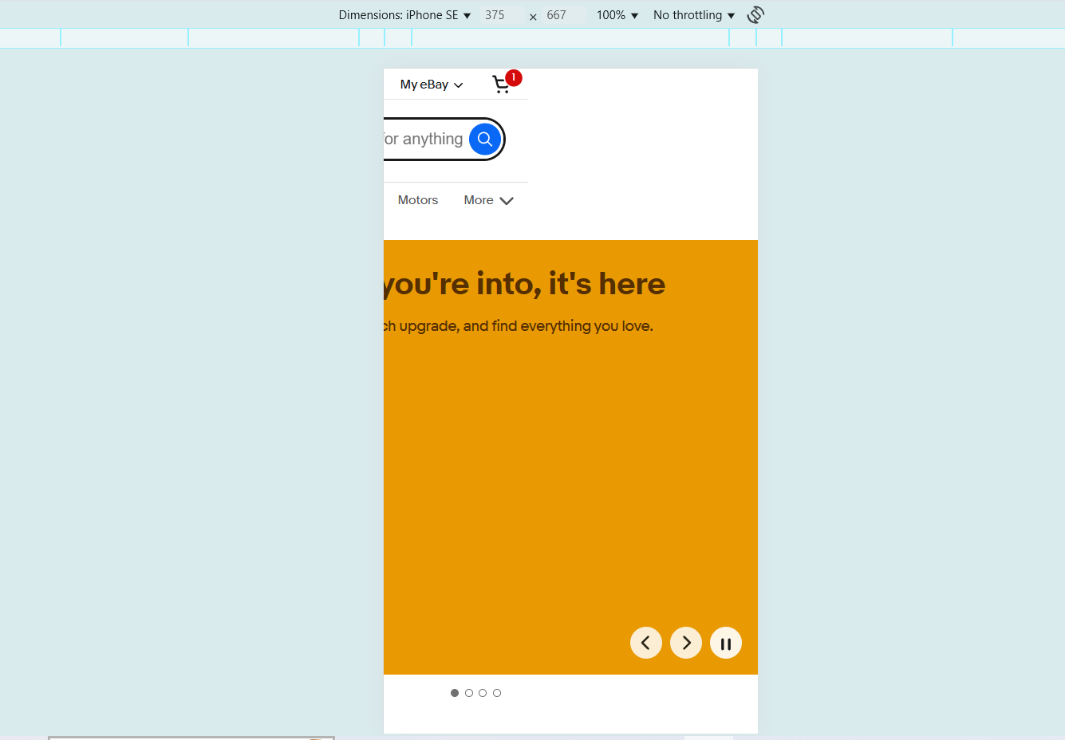

Slide 12
Defect identifier :- D_002
Ø Defect summary :- Ship to button is highlighted in one page
Ø Test Id :- TC_002
Ø Test case name :- TC_shipto
Ø Module name :- Ship to button
Ø Reproducible :-
Ø Severity :- MEDIUM
Ø Priority :- MEDIUM
Ø Raised by :- Team lead
Ø Assigned to :- developer Team lead
Ø Date of assignment :-18/08/2025
Ø Status :- pending
Ø Fixed by :- developer
Ø Date of fixing :-

Slide 13
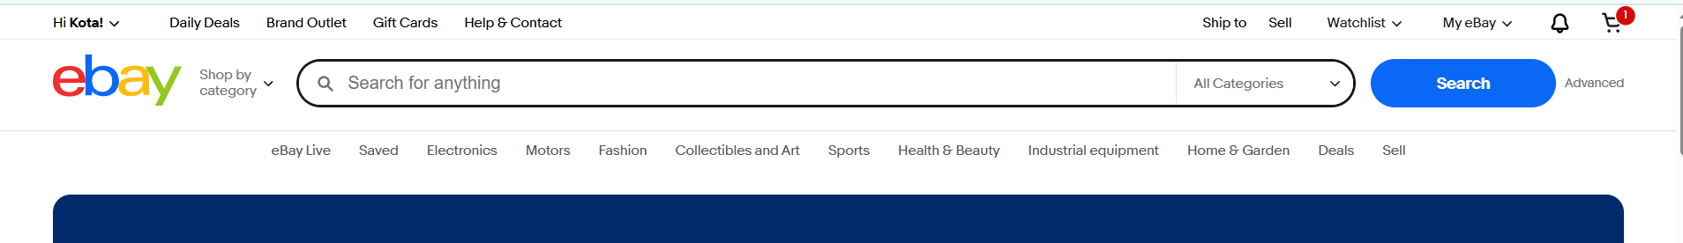
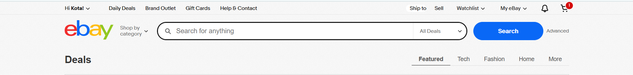

Slide 14
CHALLENGES:
Difficulties with multi-tab navigation during cart operations
Hover menus and dynamic elements
Tests failing randomly due to slow page loads
CAPTCHA/verification interrupting automation flow.

Slide 15
EXPERIENCE:
Automated critical user flows including login, product search, cart management, and checkout processes.
Worked with real-world scenarios like profile updates and address modifications.
Gained experience in testing both frontend UI elements and backend functionality.
Implemented solutions for multi-tab navigation and complex user interactions.
Learned to handle test failures.

Slide 16


